Slide 1
8051 timer section

Slide 2
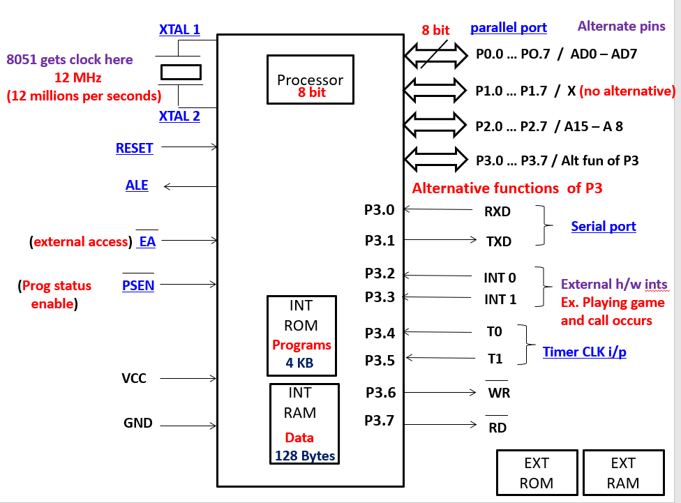
8051
Memory
ROM
Processor
Programs
4 KB
8 bit
RAM
Data
128 Bytes
RXD
Serial port
TXD
I/O ports
Timer
2, 16 bit
8 bit
P0
P1
P2
P3

Slide 3
Delay
Software delay
Hardware delay
Software delay generated by using NOP instruction.
By putting NOP instruction into the loop delay can be achieved.
But processor again involve for fetching decoding and executing this instruction.
Timer is used to generate hardware delay

Slide 4
Timer is used to produce a delay
For example : Air Conditioner
We set the off time or on time for AC, for this needs to generate delay of specific time.
If processor is responsible to generate delay it will not able to perform other task like controlling temperature, display temperature on screen and etc.
So to make processor free to perform other important operations timer is used to generate the delay
Once delay over timer will inform to processor to do the related task.

Slide 5
1. To generate delay first we need to
load count value.
2. In case of 8051, 16 bit counters are
used.
There fore count value is 16 bit number i.e. 65,535
Range for counter is 0000 to FFFF
To hold count value we required special registers i.e. SFR
But SFR is 8 bit , so we required 2 , 8 bit SFR
There are two types of counter
2 , 16 bit up - counter
To produce two delay simultaneously two timers are used
UP
5
4
3
2
1
0
DOWN
5
4
3
2
1
0
T0 (16)
4 SFR
T1 (16)
2 SFR
2 SFR
TH0 (8)
TL0 (8)
TH1 (8)
TL1 (8)
Example count = 0005 H
0000
0 0 0 5 H
MOV TL0 , # 05H
MOV TH0 , # 00H
H
L
0006
When counting is over timer will send an interrupt to processor through TF tag (TF0 , TF1)
CLK
0007
Count(16)
0005 H
Timer Overflow
0008
When counting is over timer will send an interrupt to processor by setting TF = 1
When counter is incremented after FFFF H it will rollback to the 0000 H and this event is called as Timer Overflow
FFFF

Slide 6
TF :
Timer overflow flag is used indicate the overflow of counter
It is also used to store pending status of interrupts ( INT 0 , INT 1 , serial interrupt)
In 8051 whenever any event occurs which is suppose to be interrupt first of all TF flag become 1
Steps :
Load count
Apply clock pulse
Timer send interrupt
When counting is over timer will send an interrupt to processor by setting TF = 1
Program
ISR
TF0 =0
INT (TF0 =1)
Before load count value we need to calculate count value

Slide 7
How to calculate count value :
If down counter :
Count(16)
0005 H
1
2
3
4
5
0005
Counting over means overflow of timer
1
0004
0003
2
0002
3
0001
4
We required exact 5 clock pulses
5
0000

Slide 8
Up counter :
Count(16)
0005 H
Count(16)
0005 H
CLK
1
2
3
4
5
0000
0000
FFFB
Counting over means overflow of timer
1
FFFC
There fore +1 is used
0006
2
FFFD
0007
Timer Overflow
FFFE
3
0008
FFFF
4
5
FFFF
Count value = FFFF – 5 + 1
= 65535 -5
= 65530 + 1
= 65531 (FFFB H)
Formula for count value = Max count – Desired count + 1

Slide 9
Difference between counter and timer :
Timer and counter are not exact same
They are almost same
Its totally depend upon the intension of programmer whether device is used as a counter or timer
Timer :
0 1 2 3 4 5
Space between digits are fixed
Counter :
0 1 2 3 4 5
Space between digits are not fixed

Slide 10
Example :
A company manufacturing some product.
There is a conveyor belt which is used to pass the product
And packaging department having container to collect the product
The condition is one container should contain only 100 products.
Conveyor belt
One container should contain 100 products
Somebody needs to count the product
Company
Product
Packaging department
person
programming
(Manual process)
(Mechanical process)
Automation
Transmitter
Laser light for counting
Conveyor belt
Counting can be done by Laser Light
One container should contain 100 products
1. Light is continuously falling
2. At the receiver side there is a photo cell.
3. The moment light appear on photo cell it will be in logic 1
state.
4. When product pass it through this light it will cut the rays,
so photo cell will change it’s state from 1 to 0.
5. When product pass away from light again it will become logic 1
Company
Product
Receiver
Packaging department
Photocell : light on gets charged

Slide 11
Count(16)
0005 H
CLK
Example 1 :
Transmitter
Laser light for counting
One container should contain 100 products
Product
Receiver
Photocell : light on gets charged
Example 2 : In bank counting notes

Slide 12
TCON
TIMER Control
TIMER
INTRRUPT
TF1
TR1
TF0
TR0
IE1
IT1
IE0
IT0
1 = Timer overflow
(Auto cleared)
1 = Edge triggered
0 = Level triggered
1 = If external interrupt occurs
(Auto cleared)
1 = RUN
0 = STOP
(Software Control )
First 4 bits of TCON are related with Timer to control the timer
Last 4 bits of TCON are purely related with external interrupt

Slide 13
Timer Bits
TF0 & TF1 (Timer Overflow Flags) :
These bits are 1 , when timer overflow occurs and auto clear
Both are independent overflow flags, not depend upon each other. Which means one flag can be set and other can be auto clear.
TR0 & TR1 (Timer Run Bits) :
This bits are used to RUN or STOP the timer.
When this bit is 1 then timer should start to run and when 0 then timer should stop.
These bits are software control bits , which means through software, programming or using instruction programmer can start or stop these bits.
Example : SETB TR0
CLR TR1
BACK

Slide 14
XTAL 1
8051 gets clock here
12 MHz
(12 millions per seconds)
Divide by 12
Counter
If external freq is used which is variable
XTAL 2
1 Mhz
T0
Timer
If internal freq is used which is unchanged
External clock
T1
If frequency is fixed
If frequency is variable

Slide 15
Interrupt Bits
IE0 & IE1 (Interrupt Enable Flags) :
When interrupt occurs processor will go into the ISR, but in 8051 when interrupt occurs some flag will become 1.
There are two hardware / external interrupt pins i.e. INT0 and INT1 in case of 8051, hence IE0 and IE1 these two separate flags are available.
Whichever interrupt occur these flags become 1 and then processor come to know that interrupt is occur.
As soon as processor will enters into the respective ISR these flags will auto clear.
BACK

Slide 16
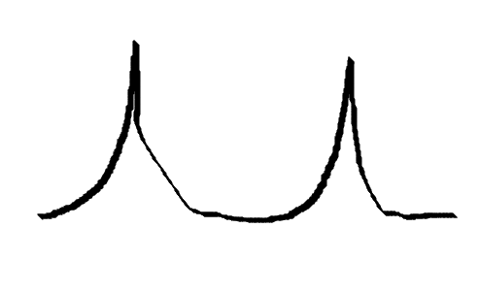
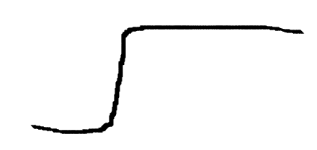
Interrupt Bits
IT0 & IT1 (Interrupt Type Flags) :
When interrupt occurs on any one of the pin or on both pin (INT0 & INT1) of 8051, the status of these pin will be 1 because these are active high signal
Interrupt
Edge Triggered
Level Triggered
Interrupt recognized on edge is called as edge triggered interrupt
Interrupt recognized on level is called as level triggered interrupt
Example : on mobile screen we want to display M letter multiple time and continuously , so we need to press and release button continuously….it is called edge triggered
Example : on mobile screen we want to display only M constantly, so we need to press button for long time without releasing the button….it is called level triggered
For computer keyboard exact opposite scenario
BACK

Slide 17
Example : Programmer has loaded value 69 h in TCON , explain what is happened ?
TIMER
INTRRUPT
TIMER 1
TIMER 0
Interrupt 1
Interrupt 0
0
1
1
0
1
0
0
1
=
69 H
TF1
TR1
TF0
TR0
IE1
IT1
IE0
IT0
Timer 0 is stop
It has accured
It has not accured
No timer overflow occurs for timer 1 means timer 1 is still counting
Timer overflow occurs for timer 0 means timer 0 is not counting
It is level triggered
It is edge triggered
Timer 1 is running

Slide 18
TMOD
Interrupt through button
Hardware control for timer no interrupt option
TIMER Mode
XTAL 1
INT0
T1
T0
Button
To start or
Stop timer
Gate
C/T
M1
M0
Gate
C / T
M1
M0
Divide by 12
INT1
XTAL 2
1 = counter
0 = timer
Two bits are used to select timer mode
Timer
If using internal clk
1 Mhz
Counter
If using external clk
T0
T0
Whenever gate term occurs in electronics which means enable
00 | Mode 0
01 | Mode 1
10 | Mode 2
11 | Mode 3
T1
T1
Timer can run or stop by two methods
Software control
By making TR0 & TR1
0/1
Hardware control
By using buttons which can connect to INT pins not timer
1 = counting is controlled by INTX(INT0 or INT1) (hardware control)
0 = counting is independent of INTX its purely (Interrupt) (timer control by software)

Slide 19
Logic diagram for TMOD
H/W control
XTAL 1
INT0
Divide by 12
INT1
Button
To start or
Stop timer
XTAL 2
fOX
Divide by 12
To transfer clock to counting this line should be enable by passing
1 Mhz
T0
T0
Internal
T
T1
T1
C/T
Clk to counting stage
C
1
T1 or T0 Pin
If this 0 then counting not take place
External
Necessary has to 1
Bcz S/W control primary
1
TR1 or TR0
1
When both input 1 then only output is 1 , if any i/p 0 then o/p is 0
1
/ 0
0
/ 1
1
Gate
1
One i/p is not sufficient
INTx for
Interrupt
or 0
1
When something 1 then output is 1 , both i/p cannot be o
INTX for timer
If o/p of gate is 0 then another i/p has to be 1

Slide 20
Modes of timer
M0 and M1 these two bits of TMOD is responsible to select mode of timer
M1
M0
0 0 | Mode 0
0 1 | Mode 1
1 0 | Mode 2
1 1 | Mode 3

Slide 21
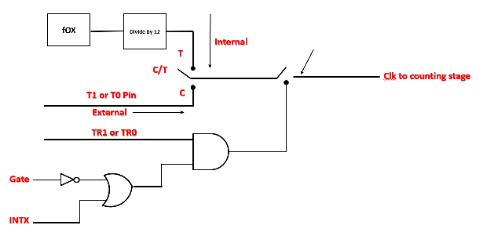
13 bit timer counter
Mode 0
05 bits
08 bits
TLx
THx
TFx
Clock
From input stage
Interrupt
TL0 or TL1 register to store lower byte of count value
TH0 or TH1 register to store higher byte of count value
TF0 or TF1 flag set when overflow occurs and generate interrupt

Slide 22
Suppose we want to increment count
How to store bytes :
H
L
3
5
If number is 35
Will always increment lower byte
3
6
7
8
When lower byte overflow it will automatically increment the higher byte
9
4
0
For TH and TL
Count value is 1234
TH
TL
TLx
THx
TFx
Interrupt
12
34
34
12
13
35
36
Always remember in diagram of modes TL is first and then TH
If these block interchange, then working of entire circuit goes wrong
FF
FF
Timer overflows and it will send interrupt
TL overflows and now HL increments
00
00

Slide 23
05 bits
08 bits
TLx
THx
TFx
1
Clock
From input stage
Interrupt
TL0 or TL1 register to store lower byte of count value
TH0 or TH1 register to store higher byte of count value
TF0 or TF1 flag set when overflow occurs and generate interrupt
1. Count value is loaded into the TL0 and TH0
In case of Mode 0 , maximum load count is 1FFF
Size of TLx register is 05 bits which means
2¹³ = 1FFF
It is used to create artificial serial port which will see in serial port section of 8086
2. At every clock pulse lower byte increment by 1
3. As soon as lower byte overflows , higher byte will start to increment.
4. As soon as lower byte overflows , higher byte will start to increment.
5. As soon as higher byte overflows , it will set the timer overflow flag and send the interrupt

Slide 24
1. 32 clk pulses
2. 32 clk pulses
05 bits
08 bits
32. 32 clk pulses
TLx
THx
TFx
1
Clock
From input stage
Interrupt
12
12
34
35
1F
1F
36
The size of TL is 05 bits i.e.
00
00
00
2⁵ = 32 i.e. 1F
Overflow
Of TL
Overflow
Of TL
Overflow
Of Tx
So after 1st 32 clock pulses TLx will overflow and the overflow of TLx will increment the THx.
This mode is used to divide frequency the by 32

Slide 25
16 bit timer counter
Mode 1
This mode is used to produces maximum delay, there fore it is preferable mode to produce delay.
Max count = 2¹⁶ = 65535 = FFFF
08 bits
08 bits
TLx
THx
TFx
1
Clock
From input stage
Interrupt
TL0 or TL1 register to store lower byte of count value
TH0 or TH1 register to store higher byte of count value
TF0 or TF1 flag set when overflow occurs and generate interrupt
FF
FF
00
00

Slide 26
8 bit timer counter with “Reloaded”
Mode 2
Reloaded counter means to load the original counter again after counting.
Once the counting over and overflow occurs at that time the original counter reloaded.
Clock
From input stage
08 bits
TLx
TFx
For
Counting
Interrupt
Enable reloaded
Mode 1
If we want fire alarm after 5 minutes
Then will use
For
Loading
THx
Mode 2
If we want fire alarm after every 5 minutes
Then will use
08 bits
We required two registers one for counting and second for
loading the original count hence mode 2 uses 8 bit counter.

Slide 27
Example :
If count value is 35 then in both reg
TLx & THx 35 is loaded.
Clock
From input stage
35
1
When TLx overflow it will send 1 to TFx and
Buffer which will enable the buffer and original
count loaded again
TLx
TFx
1
For
Counting
08 bits
Interrupt
Enable reloaded
Once to reach FF instead of 00 it will loaded
with original count i.e. 35
1
For
Loading
THx
This mode will not stop automatically until and unless program
stop it.
08 bits
35

Slide 28
2, 8 bit timer using T0
Mode 3
T1 (16)
T0 (16)
To make 3 timers available
Clock
From input stage
08 bits
08 bits
TH0 (08)
TL0 (08)
TL0
TF0
Interrupt
TF1
TF0
Clock
From input stage
08 bits
08 bits
TH0
TF1
16 bit T0 divided into two part to make two individual 8 bit timer.
Interrupt
TL0 of timer 0 uses TF0 flag of timer 0 for overflow
TH0 of timer 0 uses TF1 flag of timer 1 for overflow
T1 is used with serial port of 8051 to produce delay while serial communication. So T1 purely dedicated to serial port in that case we have only one timer left. At that time mode 3 is used
Timer 1 can counts but can’t generate overflow because all flags are used.

Slide 29
Timer program

Slide 30
To produce square wave using timer
WAP to generate square wave of 1 KHz on P1.2
To generate given Square wave on CRO we have to use following steps
To send 0 on P1.2, instruction is CLR P1.2
To send 1 on P1.2, instruction is SETB P1.2
Display (CRO)
XTAL 1
0 , 1
P1.2
By using above method following output will generate
12 MHz
Divide by 12
XTAL 2
Because 8051 do it above operation so fast it will display white screen
1 Mhz
T0
T0
1 KHz
T1
T1
0.5 ms
We have to generate square wave with equal delay :
Delay = 0.5 ms
0.5 ms
1
1
1
Because inverse of 1 KHz is 1 MS
1 ms
0
0
0
0

Slide 31
Steps for timer related programs

Slide 32
Program :
1
1
1
MAIN : | CLR P1.2 | Send 0
Count to be loaded = (FEOC)h
 | ACALL DELAY | Delay
.
 | SETB P1.2 | Send 1
0
0
0
0
 | ACALL DELAY | Delay
SELECT MODE
 | SJMP MAIN | Continue
T1
T0
IT IS A STANDARD PROGRAM OF DELAY
STEPS :
SELECT MODE
LOAD COUNT
START TIMER
DELAY: | MOV TMOD , # 01 H
 | MOV TL0, # 0C H
 | MOV TH0 , # 0FE H
 | MOV TCON , # 10 H *MOV TCON.4, #01H *SETB TR0
WAIT: | JNB TF0 , WAIT
 | CLR TR0
 | CLR TF0 RET
Gate
C/T
M1
M0
Gate
C/T
M1
M0
0
0
0
0
0
0
0
1
2. LOAD COUNT
3. START TIMER
TIMER
INTRRUPT
TF1
TR1
TF0
TR0
IE1
IT1
IE0
IT0
0
0
0
1
0
0
0
0
JNB : JUMP IF NO BIT I.E. JUMP IF TF0 = 0
THIS ISTRUCTION GETS EXECUTE TILL COUNTING IS
OVER
NOT CUMPOLSARY
BUT ALWAYS CLEAR REG

Slide 33
Step 1 : Find out timer clock (Tf) with following formula
Tf (Timer clock frequency ) = XTAL frequency (oscillator frequency) in MHz
12
** And always convert Tf into KHz by multiplying with 1000 **
Possible Oscillator frequency can be asked : (in exam)
1. | 12 MHz
2. | 11.0592 MHz
3. | 22 MHz
If not mentioned then take any 1 of given frequency and calculate
Tf which is in KHz

Slide 34
Tf (Timer clock frequency ) = XTAL frequency (oscillator frequency) in MHz
12
1. Calculation of Tf if XTAL = 12 MHz
Tf = 12 MHz = 1 MHz = 1 x 1000 = 1000 KHz
12
2. Calculation of Tf if XTAL = 11.0592 MHz
Tf = 11.0592 MHz = 0.9216 MHz = 0.9216 x 1000 = 921.6 KHz
12
3. Calculation of Tf if XTAL = 22 MHz
Tf = 22 MHz = 1.833 MHz = 1.833 x 1000 = 1833.33 KHz
12

Slide 35
Step 2 : Calculate the time (T) required to produce clock pulse
Convert into microseconds by multiplying with 1000
T (Time) = 1
Tf
1. XTAL = 12 MHz then Tf = 1000 KHz
T = 1 = 0.001 KHz = 0.001 x 1000 = 1 micro sec
1000 KHz
2. XTAL = 11.0592 MHz then Tf = 921.6 KHz
T = 1 = 0.001085 KHz = 0.001085 x 1000 = 1.085 micro sec
921.6 KHz
3. XTAL = 22 MHz then Tf = 1833.33 KHz
T = 1 = 0.0005454 KHz = 0.0005454 x 1000 = 0.545 micro sec
1833.33 KHz

Slide 36
Step 3 : Find out count or delay (any one is given)
a) If delay is given then need to calculate count
Count = Given delay in (mili sec)
Always convert delay from mili sec to micro seconds by multiplying with 1000
Time (T) in micro sec
b) If count is given then need to calculate delay
Delay = Count X
Convert into micro sec dividing by 1000
Time (T) in micro sec

Slide 37
Step 4 : Calculate the count to be loaded
count value = Max count – Desired count + 1
Count value = 65535 – Desired count + 1
Convert decimal count value into hexadecimal value for loading into TH and TL SFRs

Slide 38
Step 5 : Write a program
Load mode of timer into TMOD
Load count value into TH and TL
Make port or port bit 0 or 1
Start timer (either TCON or TRx bits)

Slide 39
Timer programs

Slide 40
1. WAP to generate a pulse with the width of 5 mili sec (ms) on P1.3 , Assume XTAL = 11.0592 MHZ , timer 0 is
used with mode 1
Solution :
Step 1 : Find out timer clock (Tf) with following formula
5 ms
Calculation of Tf if XTAL = 11.0592 MHz
Tf = 11.0592 MHz = 0.9216 MHz = 0.9216 x 1000 = 921.6 KHz
ON time
12
2.5 ms
Off time
2.5 ms
Step 2 : Calculate the time (T) required to produce clock pulse
XTAL = 11.0592 MHz then Tf = 921.6 KHz
T = 1 = 0.001085 KHz = 0.001085 x 1000 = 1.085 micro sec
Delay :
2.5 ms
921.6 KHz

Slide 41
Count = Given delay in (mili sec)
Step 3 : Find out count or delay ( delay is given)
Time (T) in micro sec
Desired Count = (2.5 mili sec x 1000 ) / 1.085 micro sec
= 2500 micro sec / 1.085 micro sec
= 2304.14
= 2304
Always convert delay from mili sec to micro seconds by multiplying with 1000
Consider only integer part
Step 4 : Calculate the count to be loaded
Step 5 : Write a program
Count value = 65535 – Desired count + 1
= 65535 – 2304 + 1
= 65535 – 2303
= 63232
Load mode of timer into TMOD
Load count value into TH and TL
Make port or port bit 0 or 1
Start timer (either TCON or TRx bits)
Decimal
Hex count value = F700
Loaded into TH and TL

Slide 42
Program :
 | CLR P1.3
 | ACALL DELAY
 | SETB P1.3
 | ACALL DELAY
DELAY | MOV TMOD , # 01 H
 | MOV TL0, # 00 H
 | MOV TH0 , # 0F7 H
 | SETB TR0
WAIT: | JNB TF0 , WAIT
 | CLR TF0
 | CLR TR0
 | RET
This program only for 1 pulse
1
0
count value = F700
T1
T0
Gate
C/T
M1
M0
Gate
C/T
M1
M0
0
0
0
0
0
0
0
1
TMOD = 01 h

Slide 43
1. WAP to generate a square wave of 1KHZ on P1.4 , Assume XTAL = 12 MHZ , timer 0 is
used with mode 1
2. WAP to generate a square wave with on time of 3 mili sec and off time of 10 mili sec on all pins of port 0 ,
Assume XTAL = 22 MHZ , timer 1 is used with mode 1
3. WAP to generate a pulse with the width of 3 mili sec (ms) on P0.4 , Assume XTAL = 11.0592 MHZ , timer 1 is
used with mode 1

